Slide 1

INSTITUTE :UIE
DEPARTMENT: ALL ACADEMIC UNITS
Bachelor of Engineering (All Sections)
Subject Name and Code:
Engineering Physics 23SPH-141
Prepared by: Ms. Arminder
UNIT 3
QUANTUM MECHANICS
DISCOVER . LEARN . EMPOWER

Slide 2
COURSE OBJECTIVES
The course is designed to make the students industry ready to contribute in the growing demand of the industry at local, national and international level.
It will make the students competent to understand basic concepts and applications of advanced engineering physics and apply its principles in their respective fields at global platform.
It will enhance the skill level of the students and shall make them preferred choice for getting employment in industry and research labs.
It will give thorough knowledge of the discipline to enable students to disseminate knowledge in pursuing excellence in academic areas.

Slide 3

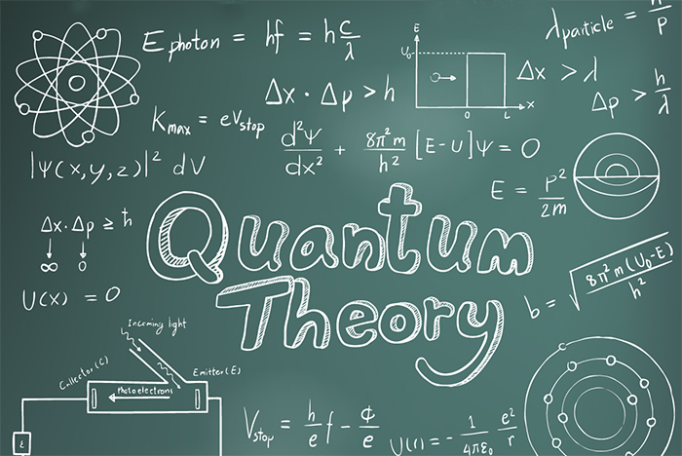
COURSE OUTCOMES
CO Number | Title On completion of this course, the students are expected to learn | Level
CO1 | Quote the basic fundamental concepts of lasers, optical fibres, crystallography, ultrasonic oscillations, semiconductor physics, quantum mechanics and nanotechnology. | Remember, Understand
CO2 | Demonstrate the working of various lasers, fibre components, semiconductor devices; explain the behaviour of crystalline solids, quantum and nano-scale systems. | Understand
CO3 | Solve problems by applying principles related to lasers, fibres, semiconductors, oscillations, quantum and nanoscience. | Applying
CO4 | Compare various lasers and fibres, semiconducting devices, crystalline materials, structures at quantum and nanoscale on the basis of their properties for industrial applications. | Analyze
CO5 | Develop various systems using lasers, fibres, semiconductors and nanomaterials for futuristic applications. | Design
Figure 1 Quantum Theory [1]

Slide 4
LECTURE OBJECTIVE
1
Students will learn about black body radiation.
2
Students will learn about special cases with change in wavelength.
3
In this lecture will derive the relations for Wien's law .

Slide 5
QUANTUM MECHANICS
Figure 1.1 Quantum Theory [1]

Slide 6
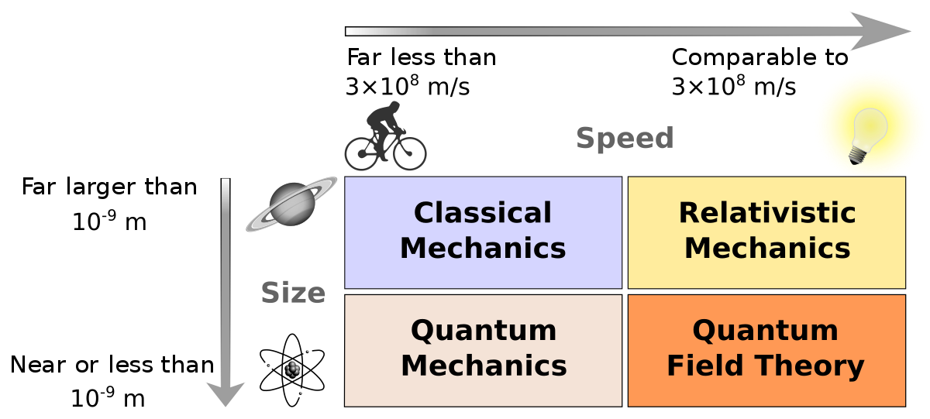
NEED OF QUANTUM MECHANICS
Problems remained from classical mechanics that relativity didn’t explain
Attempts to apply the laws of classical physics to explain the behavior of matter on the atomic scale were consistently unsuccessful.
Figure 1.2 Need of Quantum Theory [2]

Slide 7
NEED OF QUANTUM MECHANICS
Problems included:
Blackbody radiation
The electromagnetic radiation emitted by a heated object
Photoelectric effect
Emission of electrons by an illuminated metal
Figure 1.2 Need of Quantum Theory [2]

Slide 8
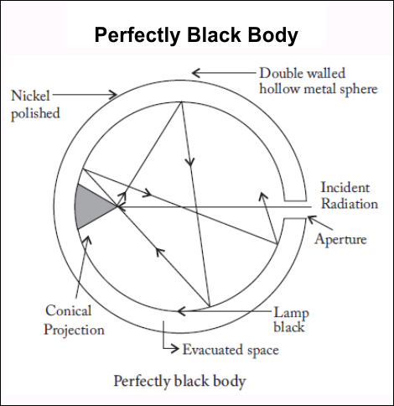
BLACK BODY APPROXIMATION
A good approximation of a black body is a small hole leading to the inside of hollow object.
The hole acts as the perfect absorber.
The nature of the radiation leaving the cavity through the hole depends on the temperature of the cavity walls
Figure 1.3 Blackbody radiations [3]

Slide 9
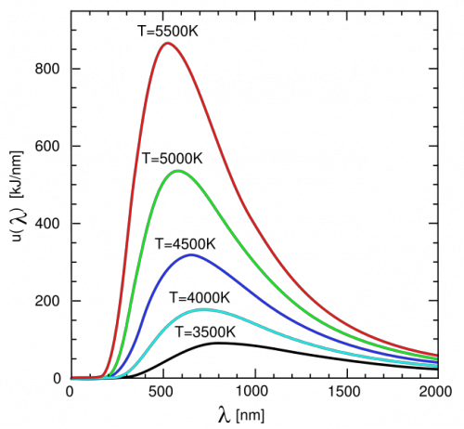
INTENSITY OF BLACKBODY RADIATION
Blackbody radiations are explained using Planck’s Quantum theory
Intensity increases with increase in wavelength, reaches maximum value and then decreases
Figure 1.4 Black body radiations [4]

Slide 10

PLANCK’S RADIATION LAW
The walls of the experimental black body consist of a large number of electrical oscillators and each one is vibrating with a frequency of its own.
An oscillator can posses only some discrete values of energy. i.e., the energy of an oscillator is an integral multiple of hν. Where ‘h’ is Planck’s constant and ‘ν’ is the frequency of vibration of the oscillator.
An oscillator may lose or gain energy by emitting or absorbing respectively a radiation of frequency ‘ν’ whose value is given by ν = ΔE/h , where, ΔE= (E₂-E₁) is the difference in energy of the oscillator before and after the emission or absorption of the radiation.
Based on the above idea, Planck derived the law governing the energy in entire spectrum of the black body radiation which is given by,

Slide 11
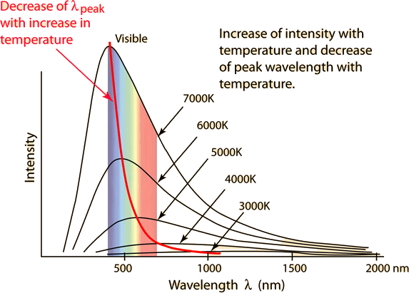
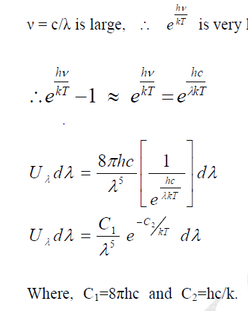
Wein’s Law
For Lower Wavelength
Figure 1.5: Variation of intensity with wavelength[5]

Slide 12
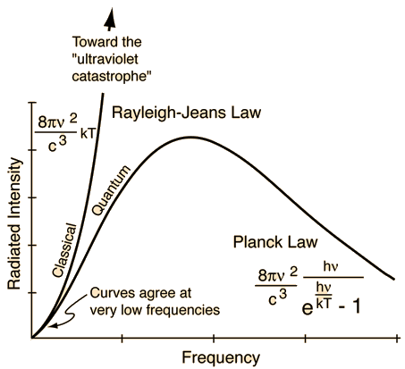
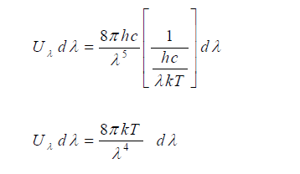
Rayleigh Jeans Law
For Higher Wavelength
ν = c/λ is small, e^{hv/kT} is also very small.
Expanding e^{hv/kT} as power series
we have,
e^{hv/kT}=1+hv/kT
Since hv/kT is very small we can neglect its higher power terms
e^{hv/kT}-1=hv/kT
Figure 1.6: Rayleigh Jeans’ law for higher wavelength[6]

Slide 13
SUMMARY
Planck assumed energy in quantised manner.
Wein’s law is applicable for short wavelength.
Rayleigh’s Jeans is applicable for higher wavelength.

Slide 14
FAQ
Explain black body.
Tabulate the assumptions of Planck’s Law of Radiation.
Draw the graph for Rayleigh’s Jeans law.

Slide 15
REFERENCES
[1] https://stradallc.com/2016/02/12/design-like-quantum-physics/
[2] https://en.wikipedia.org/wiki/Branches_of_physics
[3] https://in.pinterest.com/pin/459085755746609196
[4] https://www.e-education.psu.edu/astro801/content/l3_p5.html
[5] http://hyperphysics.phy-astr.gsu.edu/hbase/wien.html
[6] http://hyperphysics.phyastr.gsu.edu/hbase/mod6.html

Slide 16
REFERENCES
Video link
https://nptel.ac.in/courses/115/104/115104096/
https://www.youtube.com/watch?v=yVN09TdSHHg
Books
Concepts of Modern Physics, (Fifth Edition) A Beiser, McGraw Hill International.
Fundamentals of Physics, David Halliday, Robert Resnick and Jearl Walker, Wileyplus

Slide 17
THANK YOU
arminder.uis@cumail.in

